Slide 1
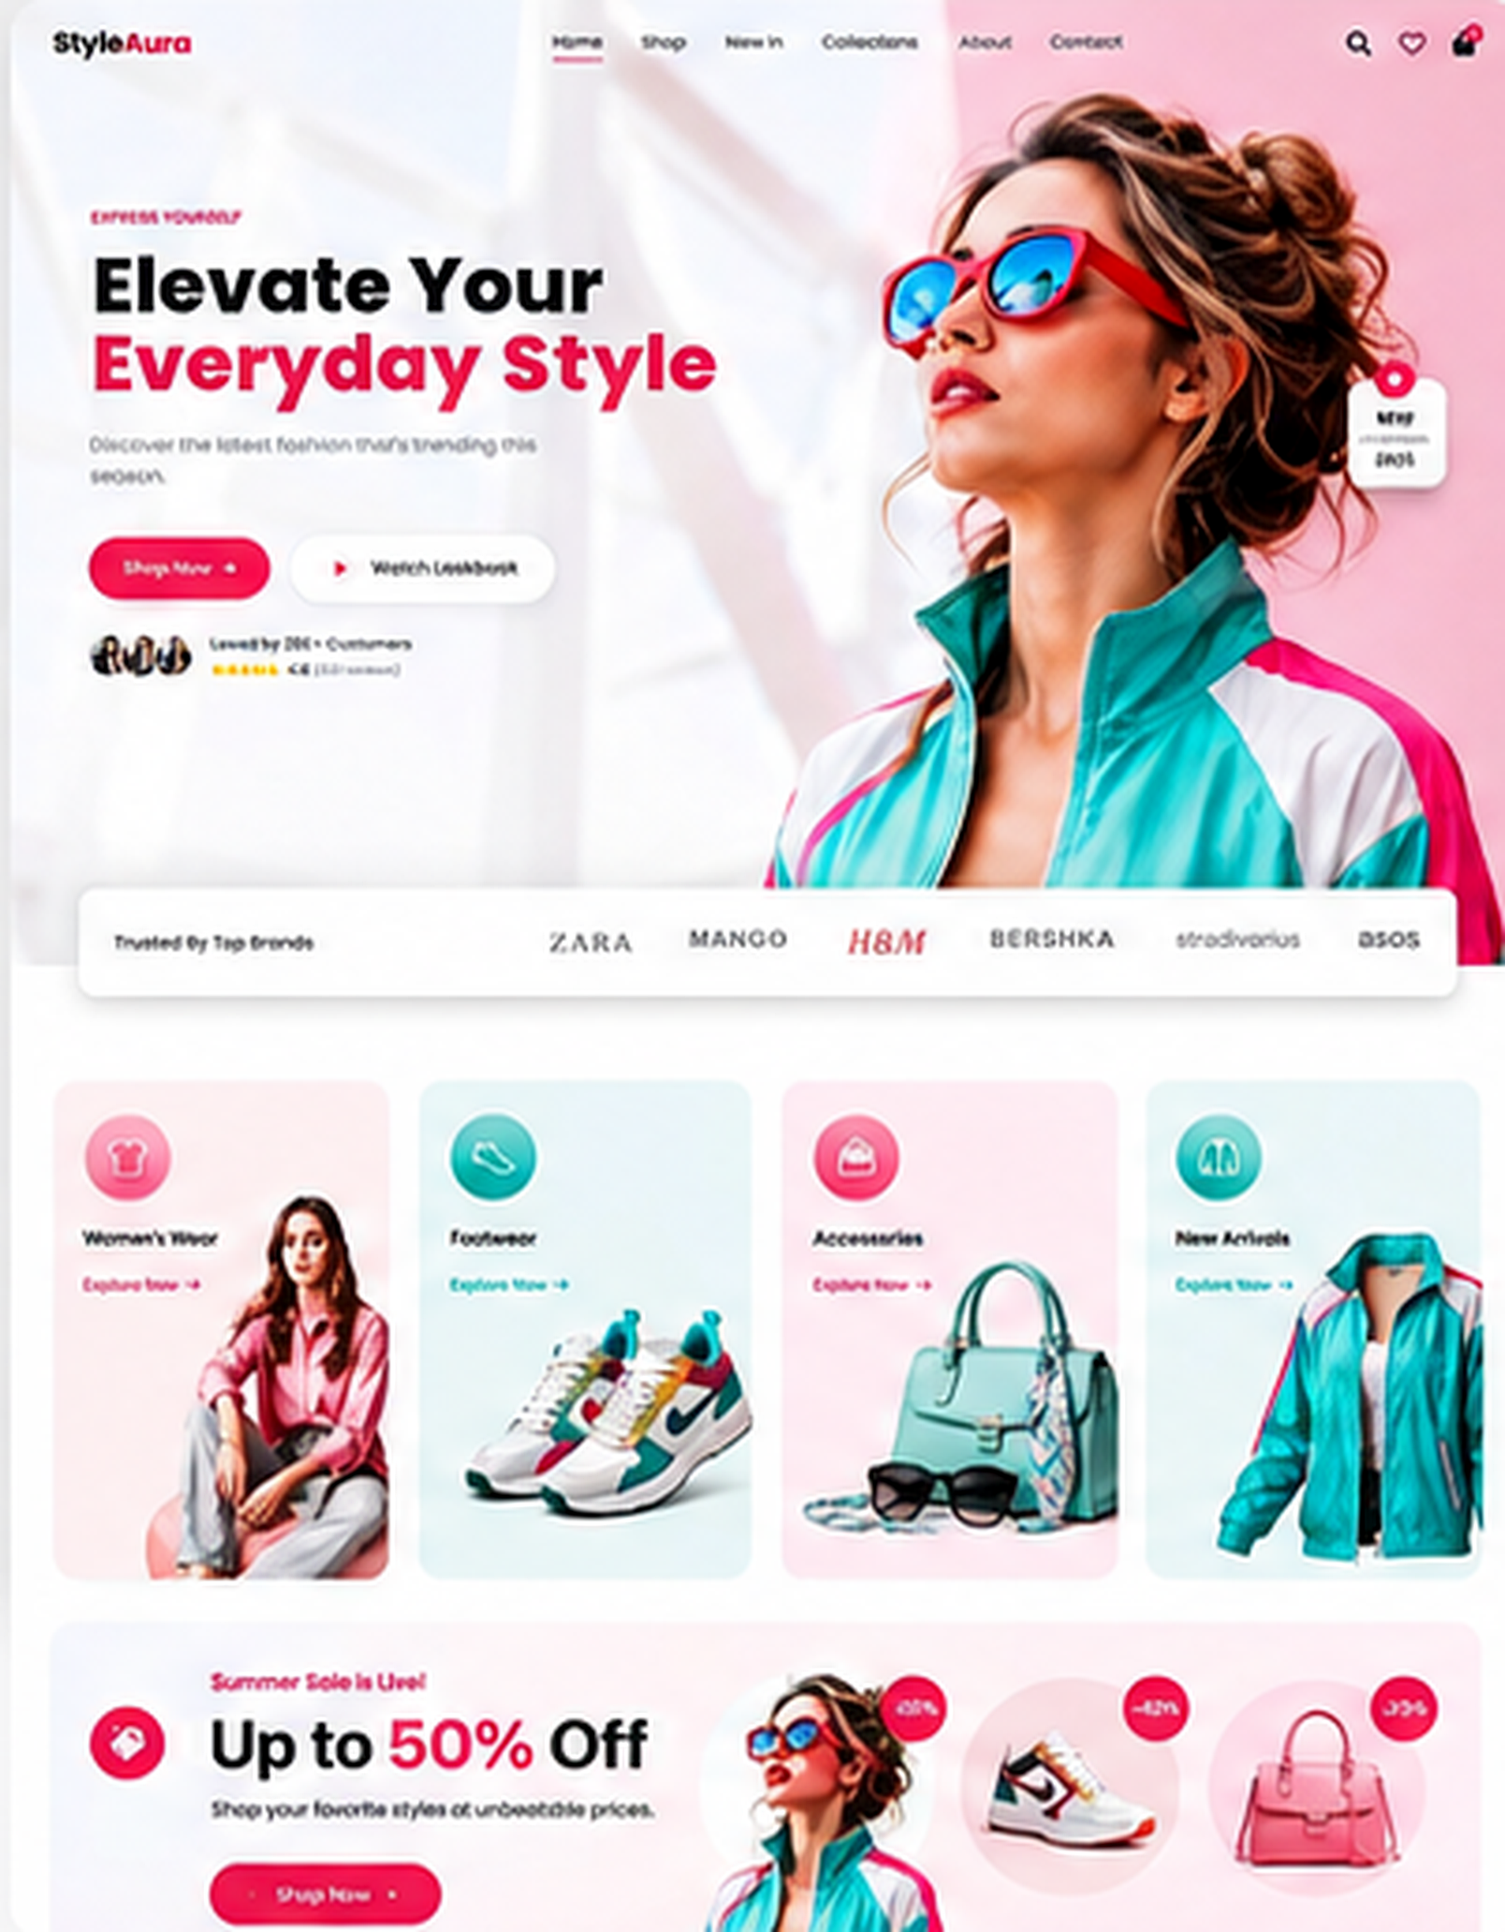
01 - Home Page

Slide 2
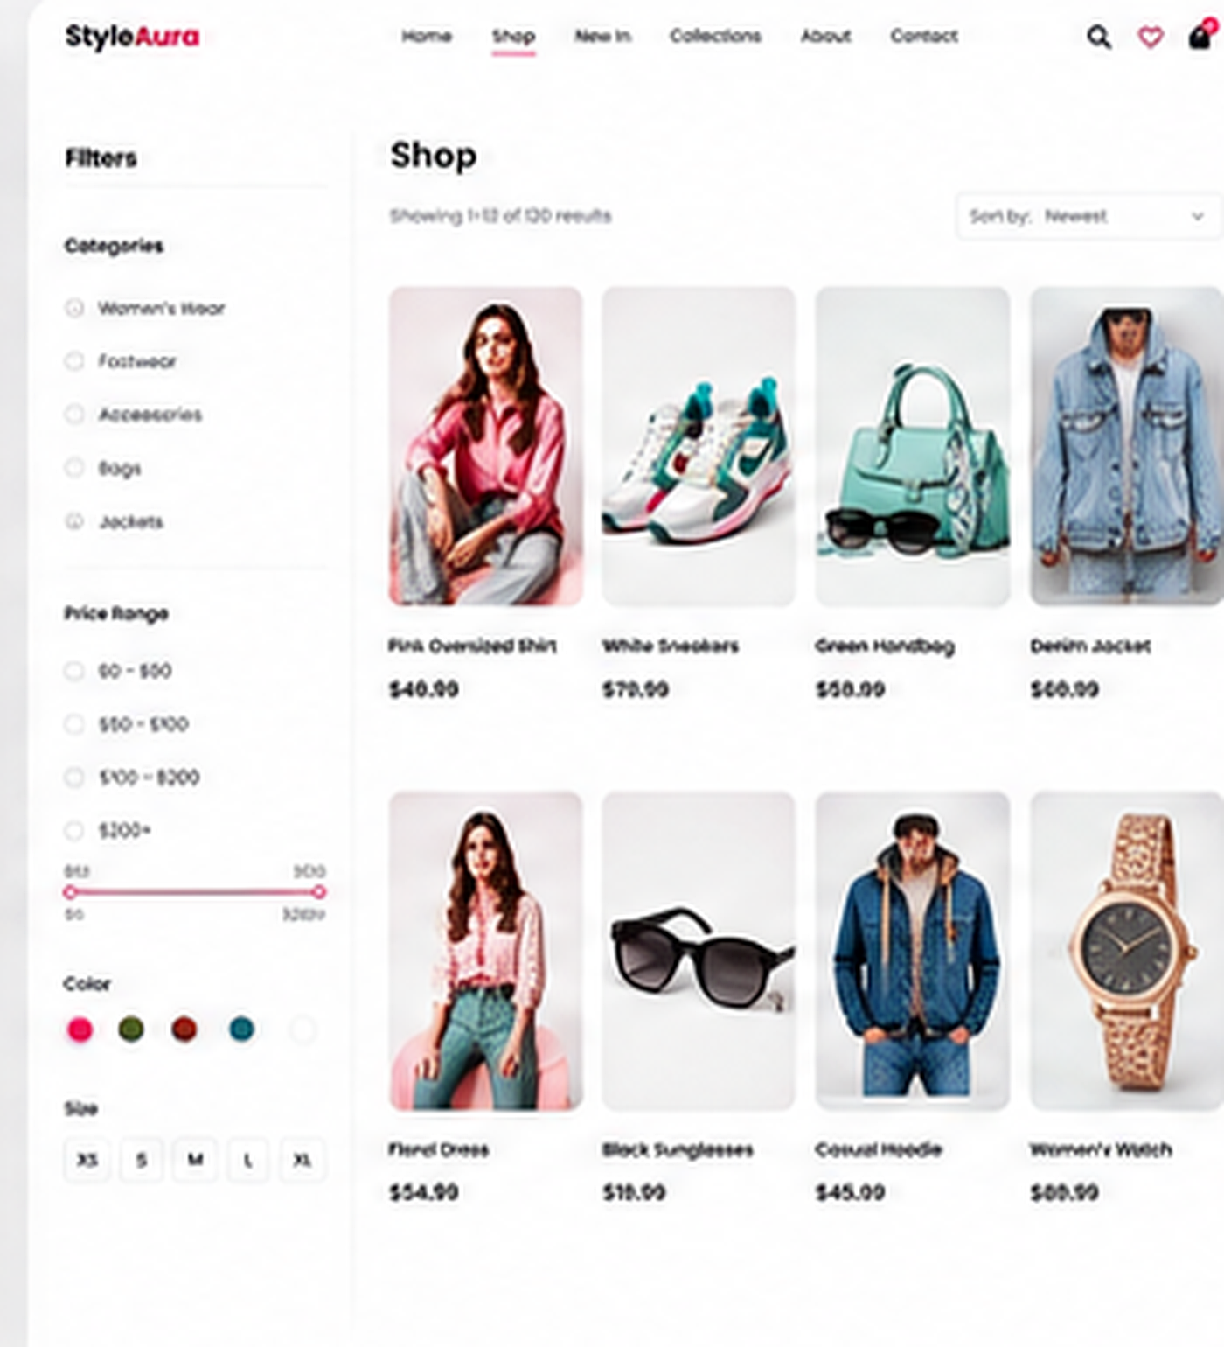
02 - Shop Page

Slide 3
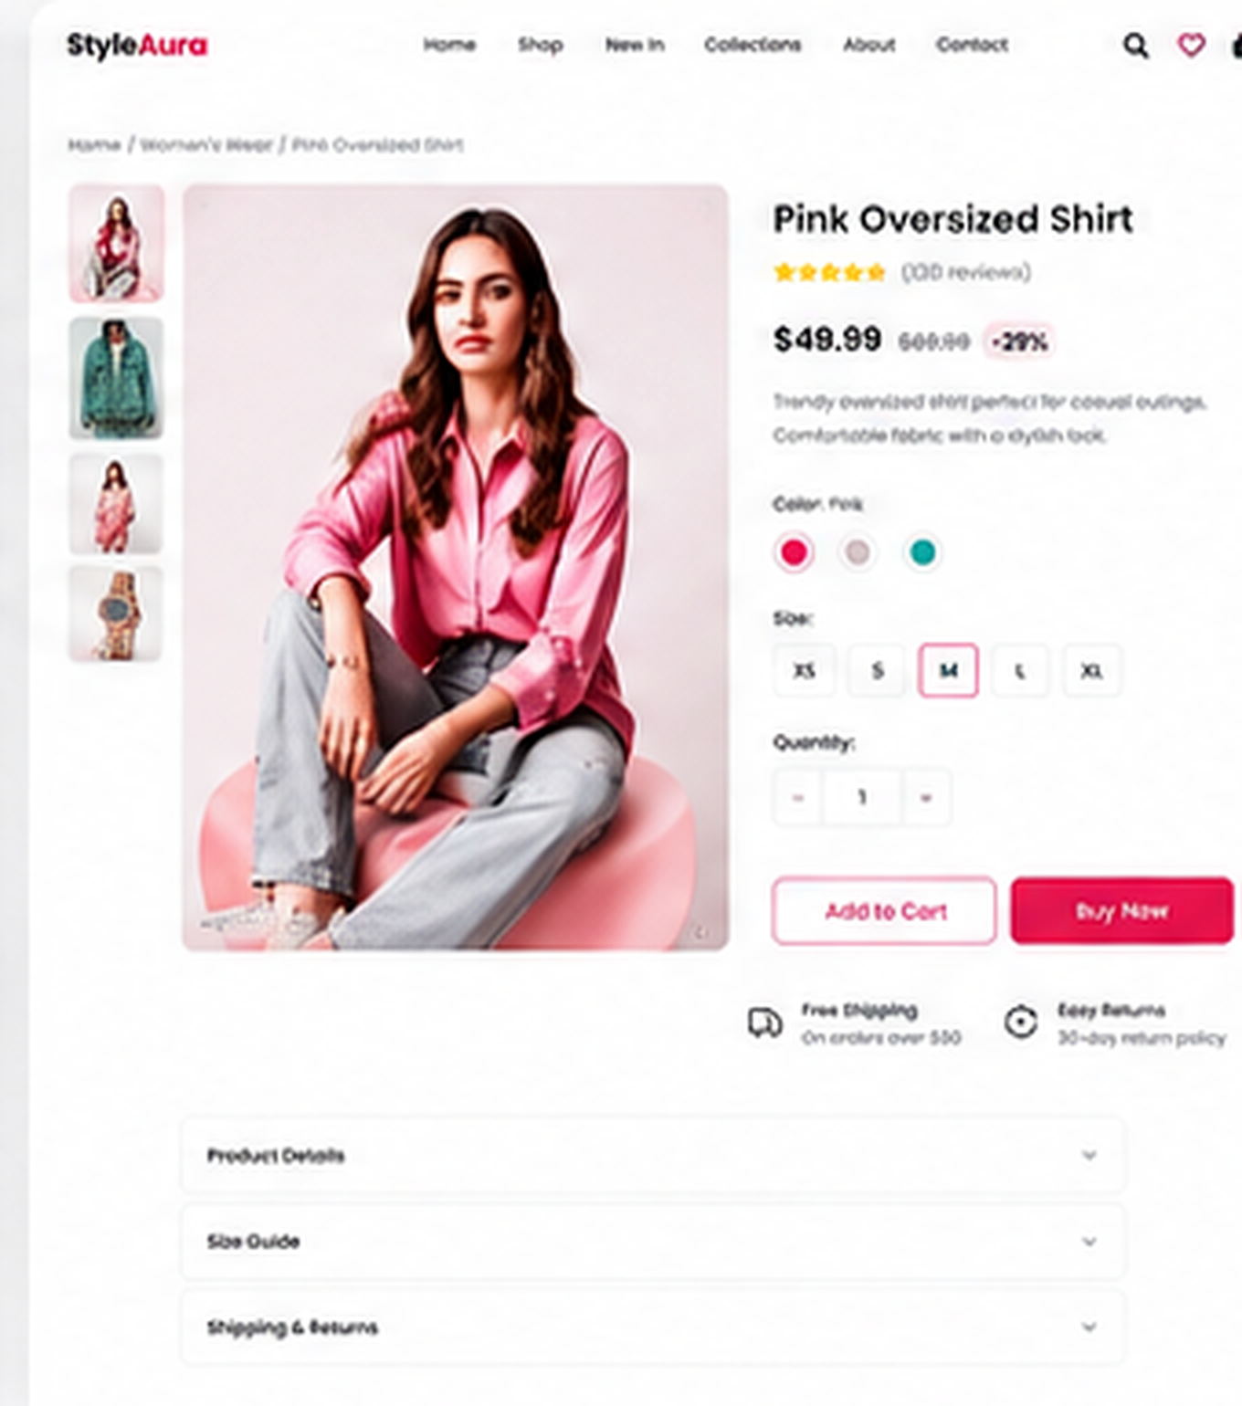
03 - Product Detail Page

Slide 4
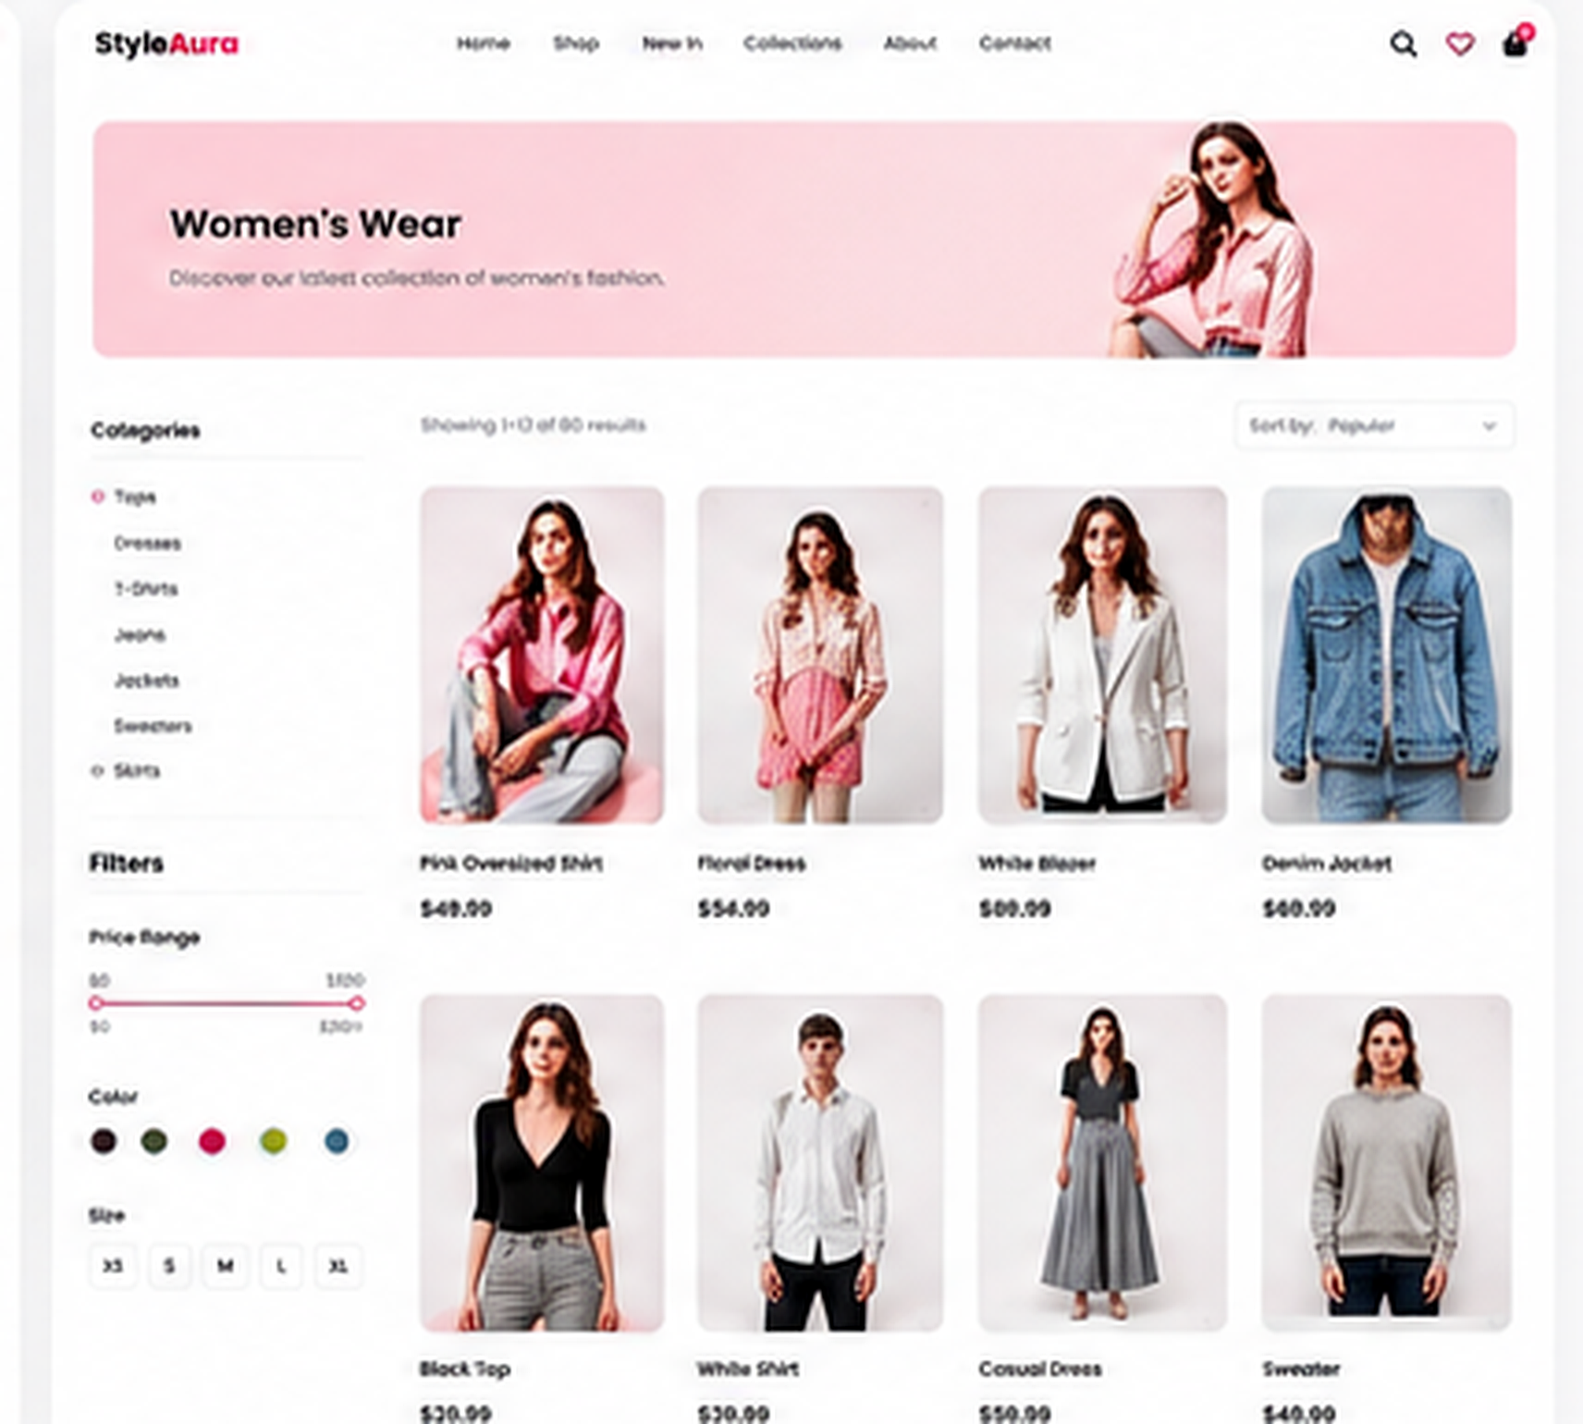
04 - Category Page

Slide 5
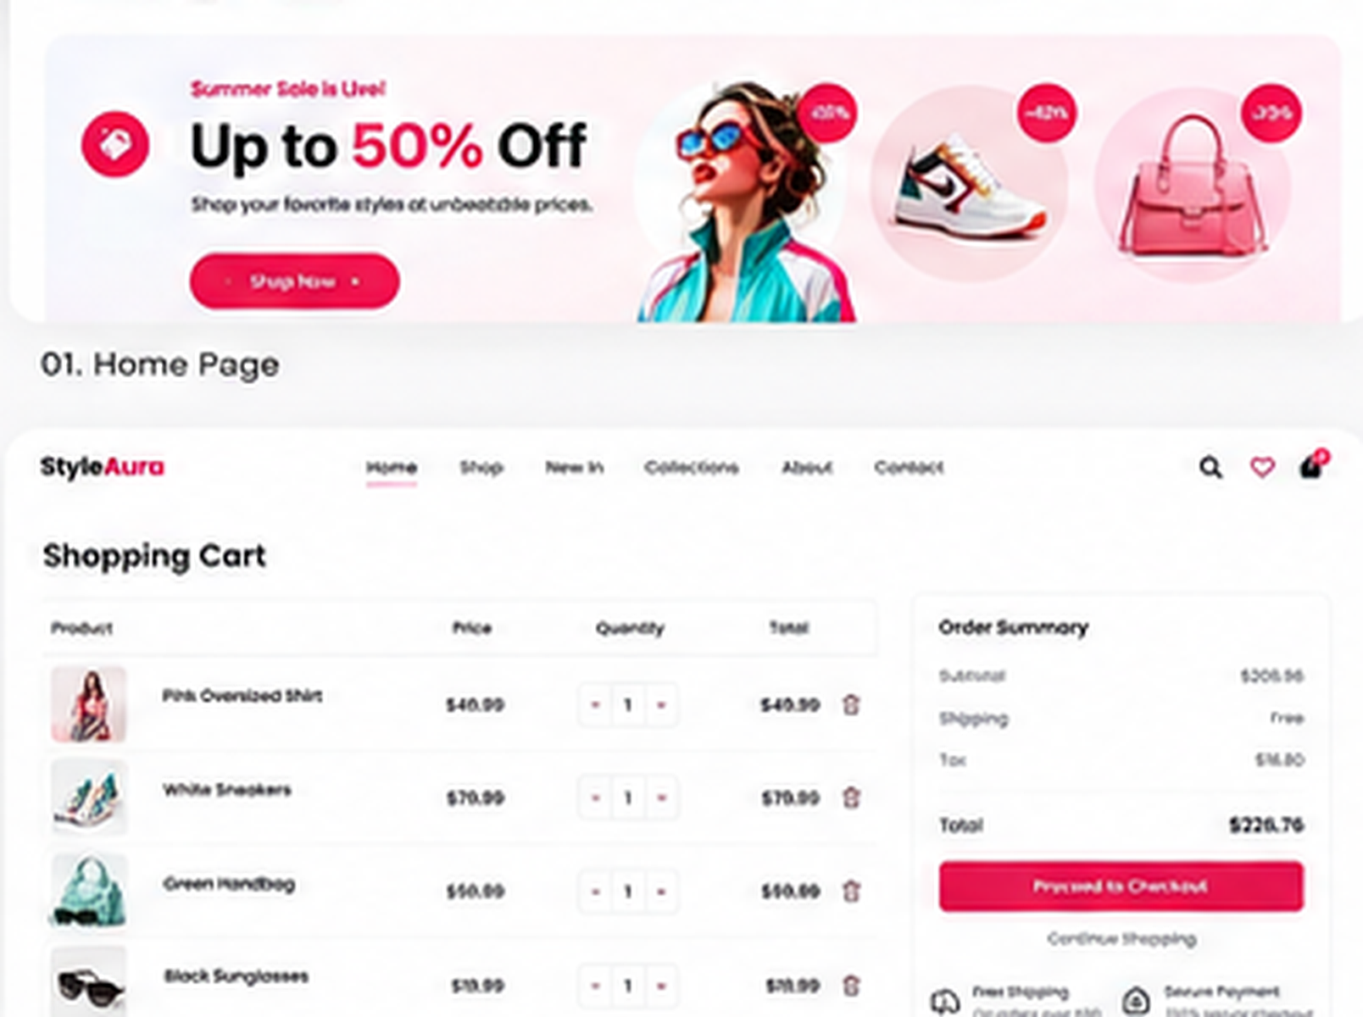
05 - Shopping Cart

Slide 6
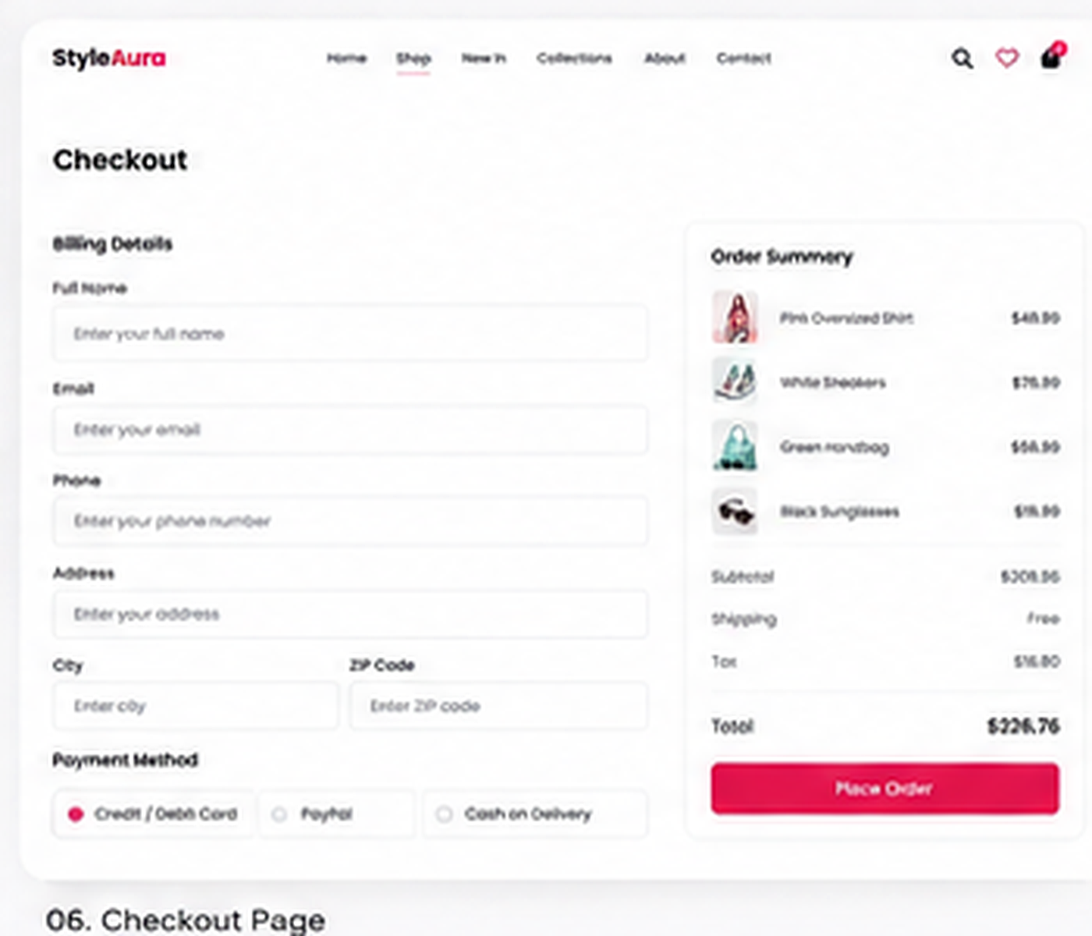
06 - Checkout Page

Slide 7
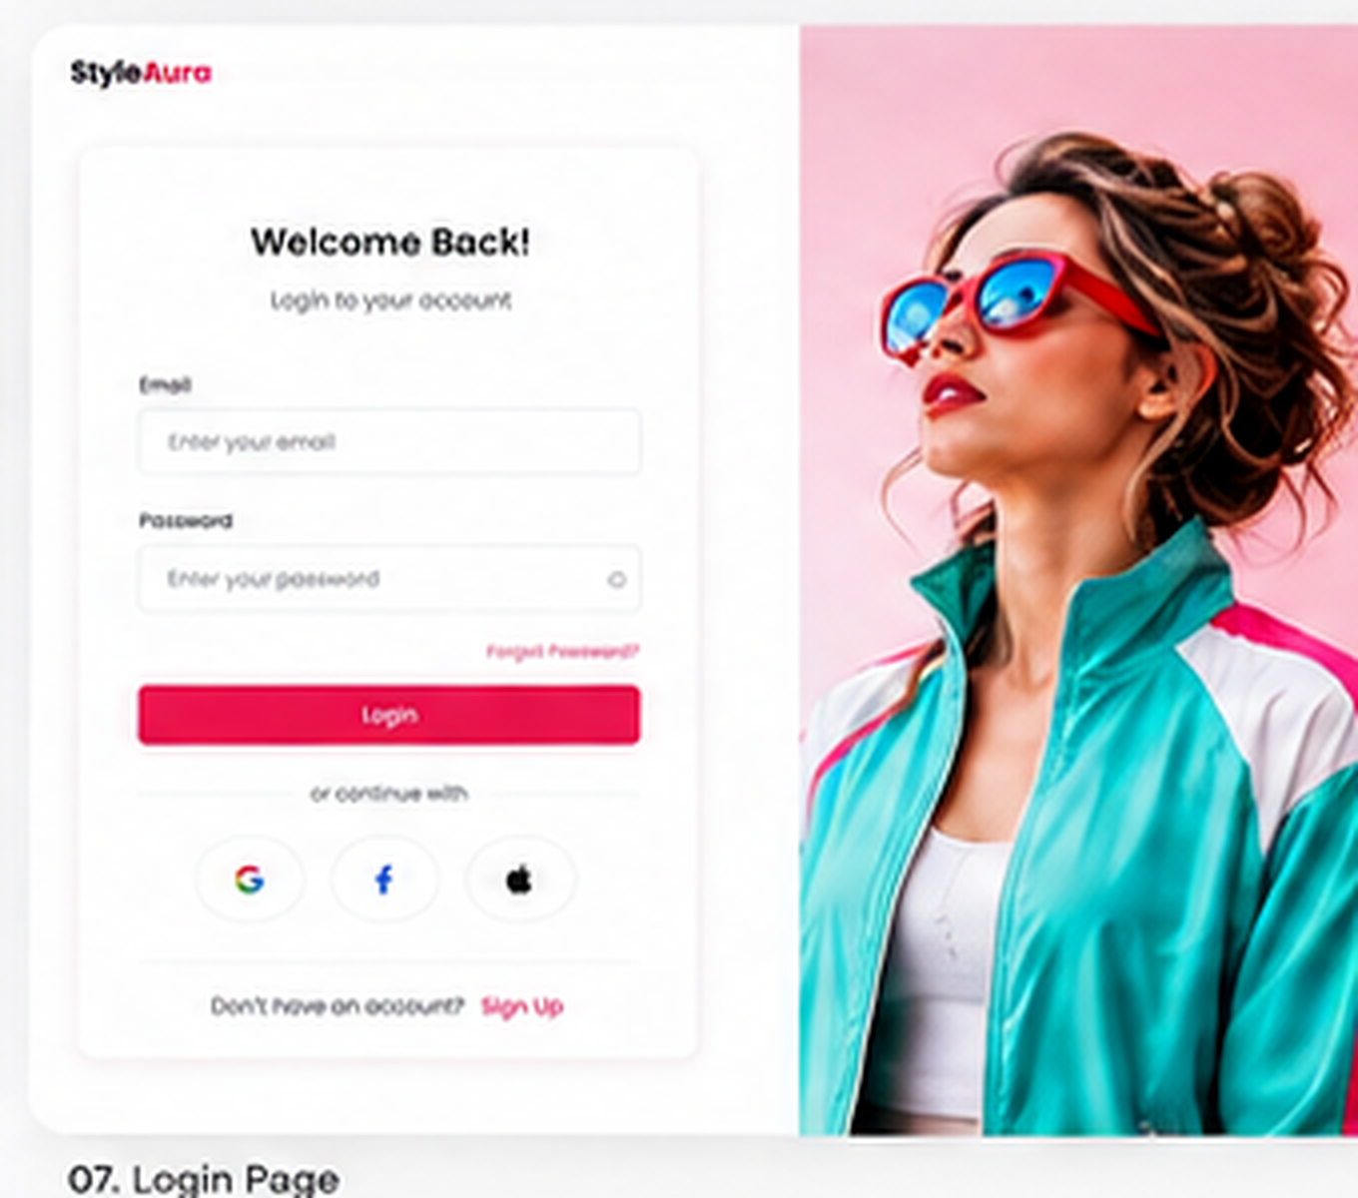
07 - Login Page

Slide 8
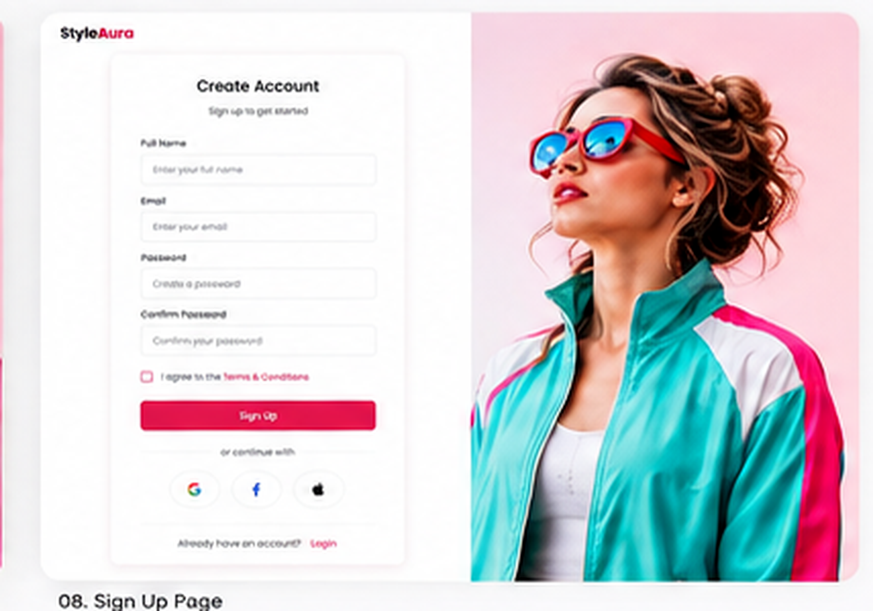
08 - Sign Up Page

Slide 9
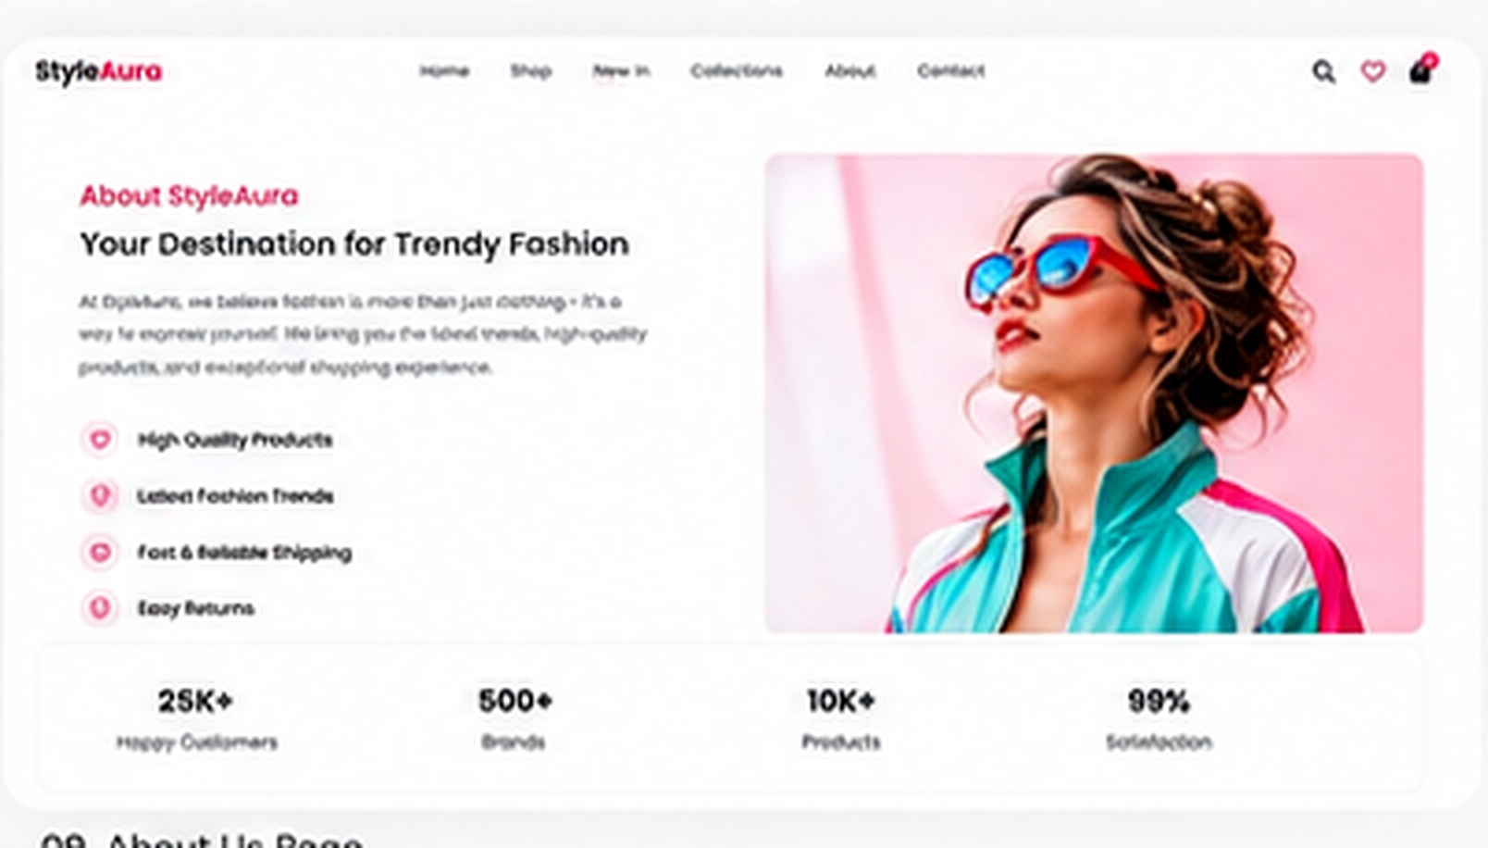
09 - About Us Page

Slide 10
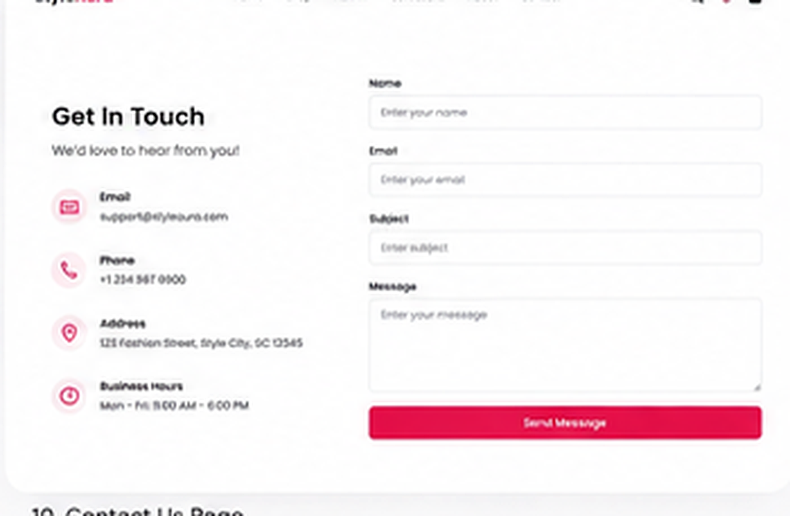
10 - Contact Us Page

Slide 11
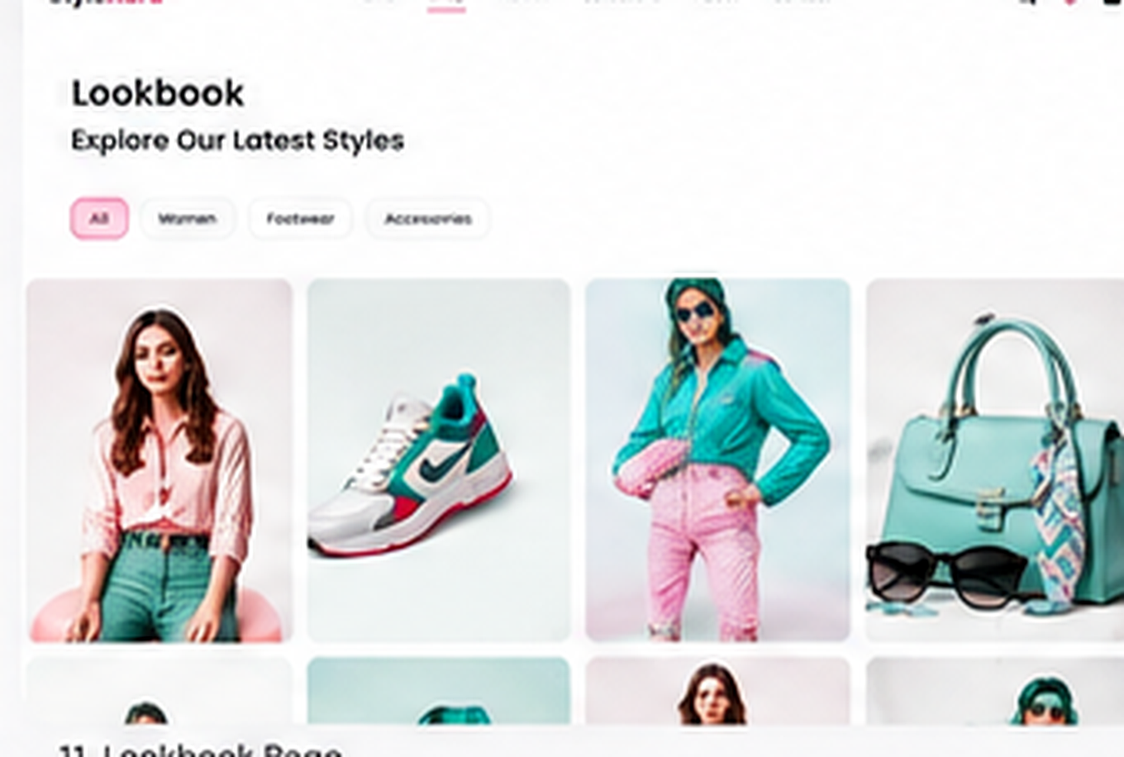
11 - Lookbook Page

Slide 12
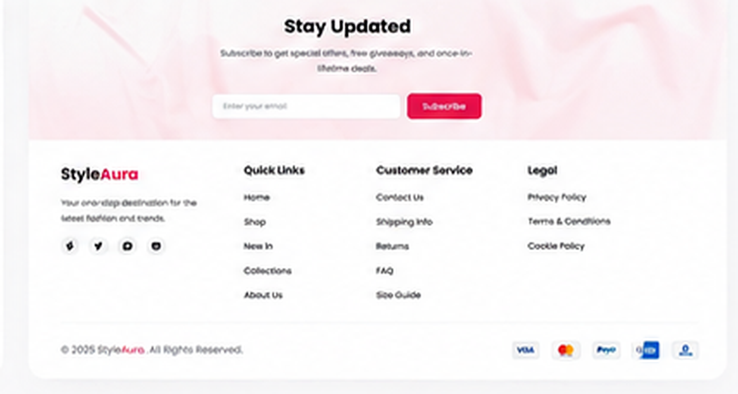
12 - Footer / Newsletter

